Slide 1
CODE MIX GENERATION
By Nikhil bishnoi
Vishal malhotra

Slide 2
What is Code Mix Data Generation
Code-mixing is the practice of alternating between two or more languages.
It is mostly observed in multilingual.
In code mix data generation, we use code mixed data as input and generate code mixed data.

Slide 3
Dataset
We took a CodeMix Corpora
The dataset was scraped from twitter and consists of hindi and english words.
The dataset consists of 16 thousand lines
The dataset consists of 28374 unique tokens.
Total 358513 words, 129577 tagged Hindi(36 %), 186537 tagged English(52%) and 26179 tagged as Other(12%)

Slide 4
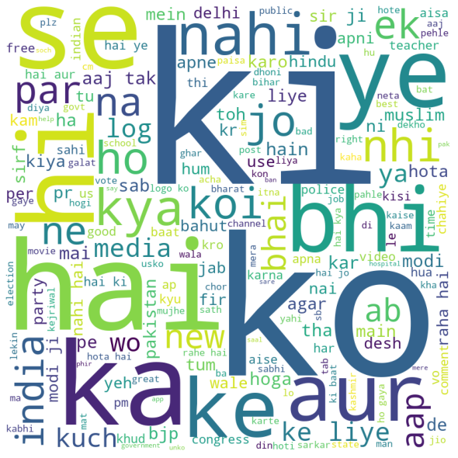
Word cloud of the dataset
Following is the word cloud of our document.
Words like ‘hai’ occurs 8369 times and ‘ki occurs 4800 times ‘hi’ occurs 2839 times , ‘ko’ occurs 5800 times and so on.

Slide 5
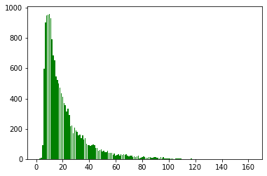
Length of sentences
The x-axis represents the length of sentences.
The y-axis represents the frequency of sentences.
Most of the sentences(960) had the sentence length 10.

Slide 6
Preprocessing
The Dataset had the following characteristics:-
The full stops were separated by space
Some of the sentences were in double quotations
Some of them had emojis in them
Preprocessing we did:-
Tokenized them by splitting them by space
We added <unk> tags to least 0.5%(150) occurring words leading to 28000 unique words.
Removed the lines which had emojis in them.
Used Microsoft LID for tagging Tokens as “Hi”,”En” and “Other” based on their language

Slide 7
Preparing Data for the model
The input text is split into sequences of length seq_length . This seq_length is a hyperparameter. The output sequence is of same length but shifted by one word. For example: For data of [1, 2, 3, 4, 5, 6], and seq_length = 5, the I/O sequences would be x = [1,2,3,4,5] , y = [2,3,4,5,6].
We decided to use seq_length = 5 to get more number of training samples from the data.
At the end we had approximately 2,00,000 I/O sequences.

Slide 8
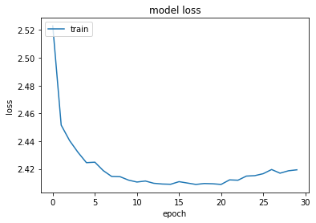
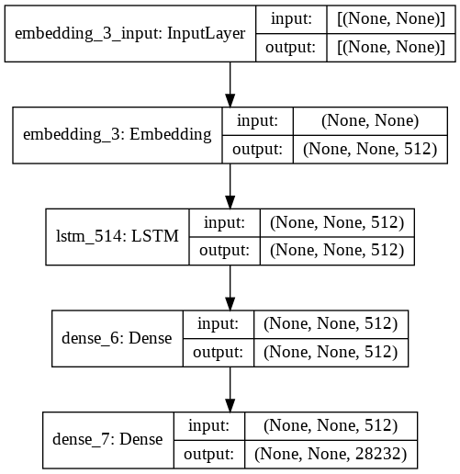
Model-1

Slide 9
Model-1 evaluation
The average perplexity of model1 on a subset of training data = 93.80.
The average perplexity of model1 on testing data = 2640.90
The code generated by giving prompt string= "ye desh ka kya haal" the model generated “ hai . india ko bhi nahi hai “.

Slide 10
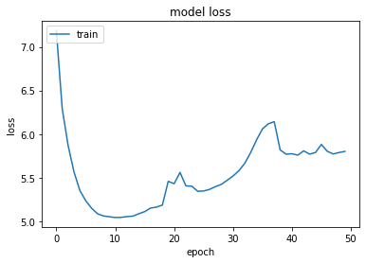
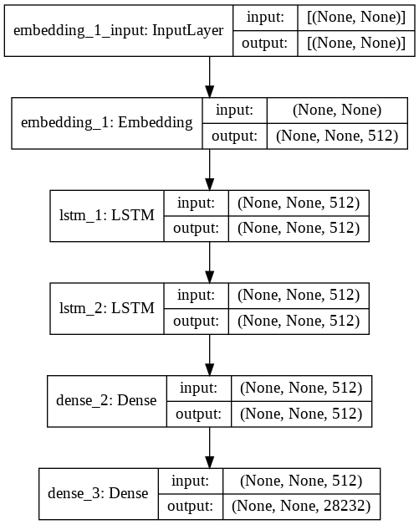
Model-2

Slide 11
Model-2 evaluation
The average perplexity of model2 on a subset of training data = 88.06.
The average perplexity of model1 on testing data = 1481.14
The code generated by giving prompt string= "ye desh ka kya haal" the model generated “ hai . or ab to kya . or ab to kya“.

Slide 12
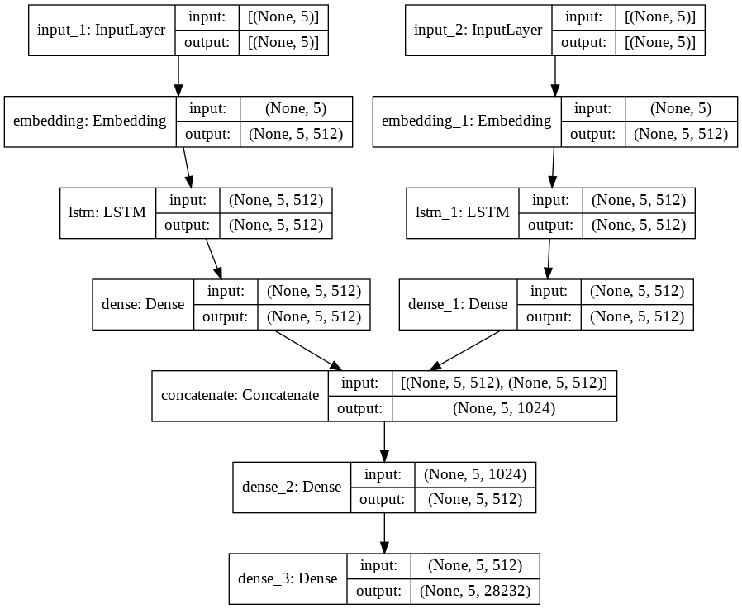
Model-3 (language informed)

Slide 13
Model-3 evaluation
The average perplexity of model2 on a subset of training data = 174.32.
The average perplexity of model1 on testing data = 3002.18
The code generated by giving prompt string= "ye desh ka kya haal" the model generated “ hai most rejected area ki aab make no one time knowledge ko follow kariye nya nothing“.

Slide 14
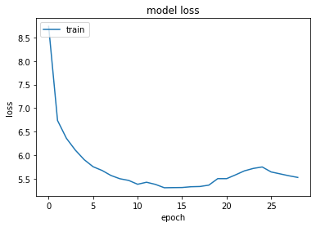
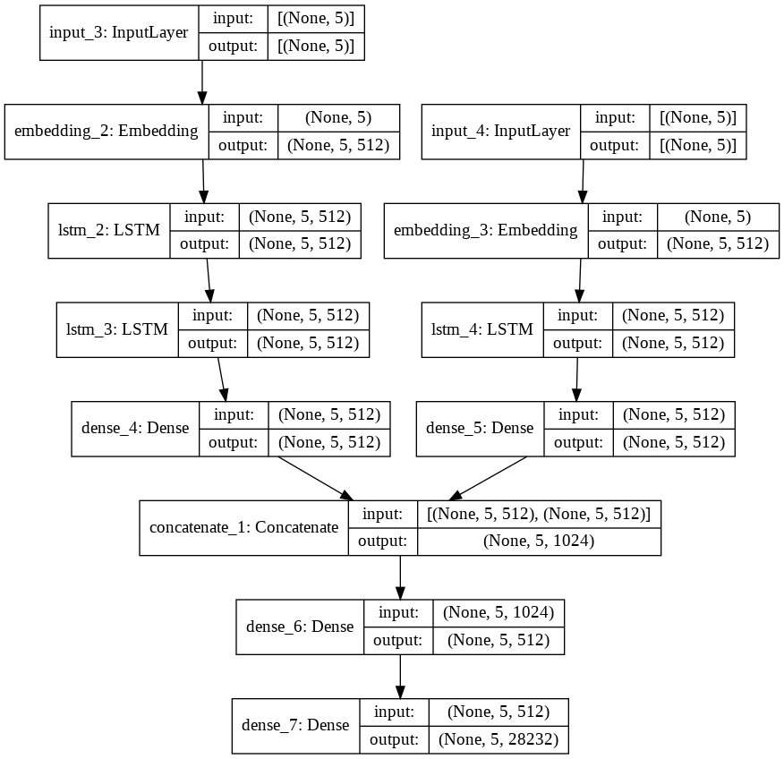
Model-4 (language informed)

Slide 15
Model-4 evaluation
The average perplexity of model2 on a subset of training data = 151.74.
The average perplexity of model1 on testing data = 2103.26
The code generated by giving prompt string= "ye desh ka kya haal" the model generated “ rahenge jese to kya 26 seconds use bi . hollywood me ghus me ghus me“.

Slide 16
Challenges
The Data scraped from twitter is not clean, different people have different styles of writing a Hindi word in a roman script, hence Identifying the token as Hindi and English is itself a big task which require 2 components :- (1) Identifying the Hindi tokens as same with different roman spelling for say, kahi,kahin and khi as a same word (2) Identifying the language of this word.
The Data required in all these models need to be very large to get good results, even the preprocessing of this large data may take a lot of time and computation power and training model often lead to OS crashes.

Slide 17
Division of work
Nikhil Bishnoi
Preprocessing and extracting LID tokens from Dataset
Report and presentation
Vishal Malhotra
Tokenization and preparing data.
Testing different model architectures.
Generating sentences and calculating perplexity.

Slide 18
Thank You
Code - https://github.com/bishboi/NLP-Project/

